Slide 1
NAVTTC – National Vocational and
Technical Training Commission
DATA ANALYTICS
Instructors: Enayat Raza (MS Data Science, NEDUET) Umair Baig (MS Data Science, NEDUET)

Slide 2
Python Data Science Handbook
Publisher: O'Reilly
1.3 : INTRODUCTION TO PYTHON

Slide 3
TOPICS
Functions (Built In)
Methods (Built In)
Packages
1.3 : Introduction to Python

Slide 4
Function
Nothing new!
type()
Piece of reusable code
Solves particular task
Call function instead of writing code yourself
1.3 : Introduction to Python

Slide 5
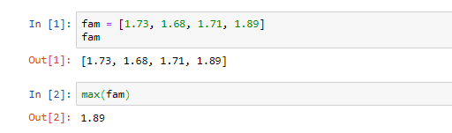
Example
Max()
fam = [1.73, 1.68, 1.71, 1.89]
1.89
1.3 : Introduction to Python

Slide 6
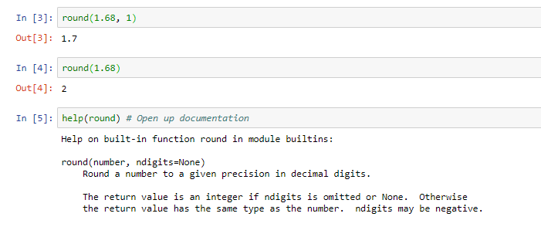
Example
round()
1.68
number
1.7
1
ndigits
1.3 : Introduction to Python

Slide 7
Example
round()
1.68
number
2
0
ndigits
1.3 : Introduction to Python

Slide 8
Find functions
How to know?
Standard task -> probably function exists!
The internet is your friend
1.3 : Introduction to Python

Slide 9
Let's practice!
1.3 : Introduction to Python

Slide 10
Methods
Built-in Functions
Maximum of list: max()
Length of list or string: len()
Get index in list: ?
Reversing a list: ?
1.3 : Introduction to Python

Slide 11
Methods
type
examples of methods
sister = ‘liz’
object
str
capitalize() replace()
height=1.73
object
float
bit_length() conjugate()
fam=[“liz”, 1.73, “emma”, 1.68, “mom”, 1.71, “dad”, 1.89]
index() count()
object
list
1.3 : Introduction to Python

Slide 12
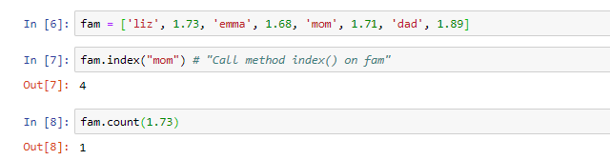
List methods
1.3 : Introduction to Python

Slide 13
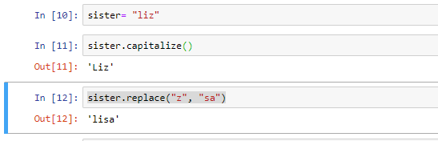
str methods
1.3 : Introduction to Python

Slide 14
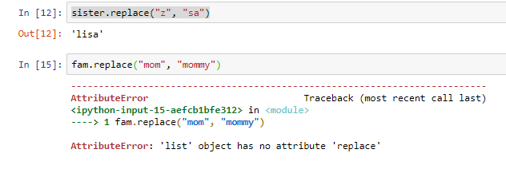
Methods
Everything = object
Object have methods associated, depending on type
1.3 : Introduction to Python

Slide 15
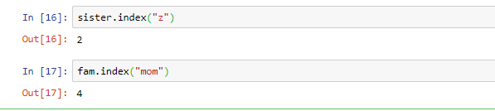
Methods
1.3 : Introduction to Python

Slide 16
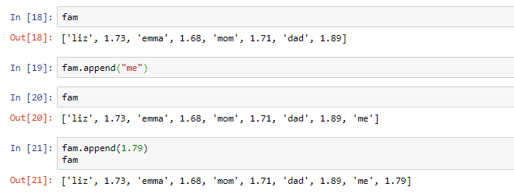
Methods
1.3 : Introduction to Python

Slide 17
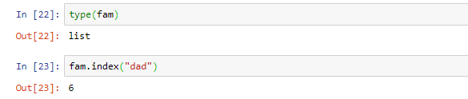
Summary
1.3 : Introduction to Python

Slide 18
Let's practice!
1.3 : Introduction to Python

Slide 19
Packages
Motivation?
Functions and methods are powerful
All code in Python distribution?
Huge code base: messy
Lots of code you won’t use
Maintenance problem
1.3 : Introduction to Python

Slide 20
Packages
Directory of Python Scripts
Each script = module
Specify functions, methods, types
Thousands of packages available
NumPy
Matplotlib
Scikit-learn
1.3 : Introduction to Python

Slide 21
Install package
http://pip.readthedocs.org/en/stable/installing/
Download get-pip.py
Terminal:
python3 get-pip.py
pip3 install NumPy
1.3 : Introduction to Python

Slide 22
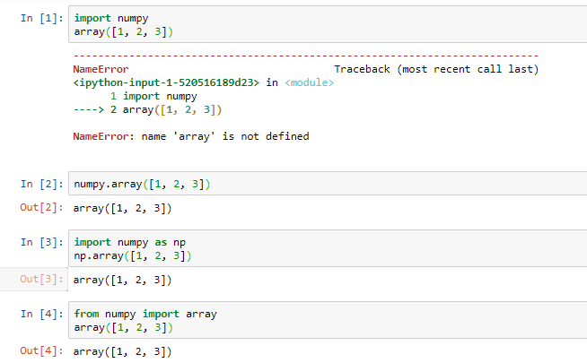
Import package
1.3 : Introduction to Python

Slide 23
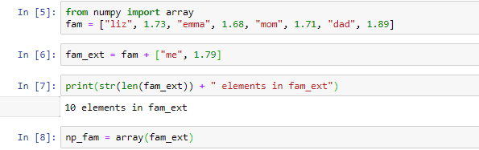
From NumPy import array
Using NumPy but not very clear
1.3 : Introduction to Python

Slide 24
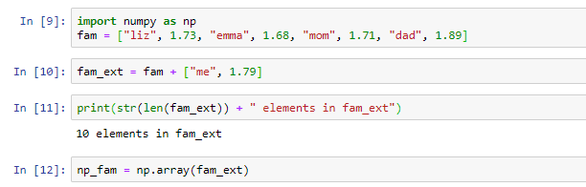
Import NumPy
Clearly using NumPy
1.3 : Introduction to Python

Slide 25
Let's practice!
1.3 : Introduction to Python

Slide 26
Thank You

